Slide 1



VELOCITY RAILWAYS DATA ENGINEERING PROJECT

Slide 2
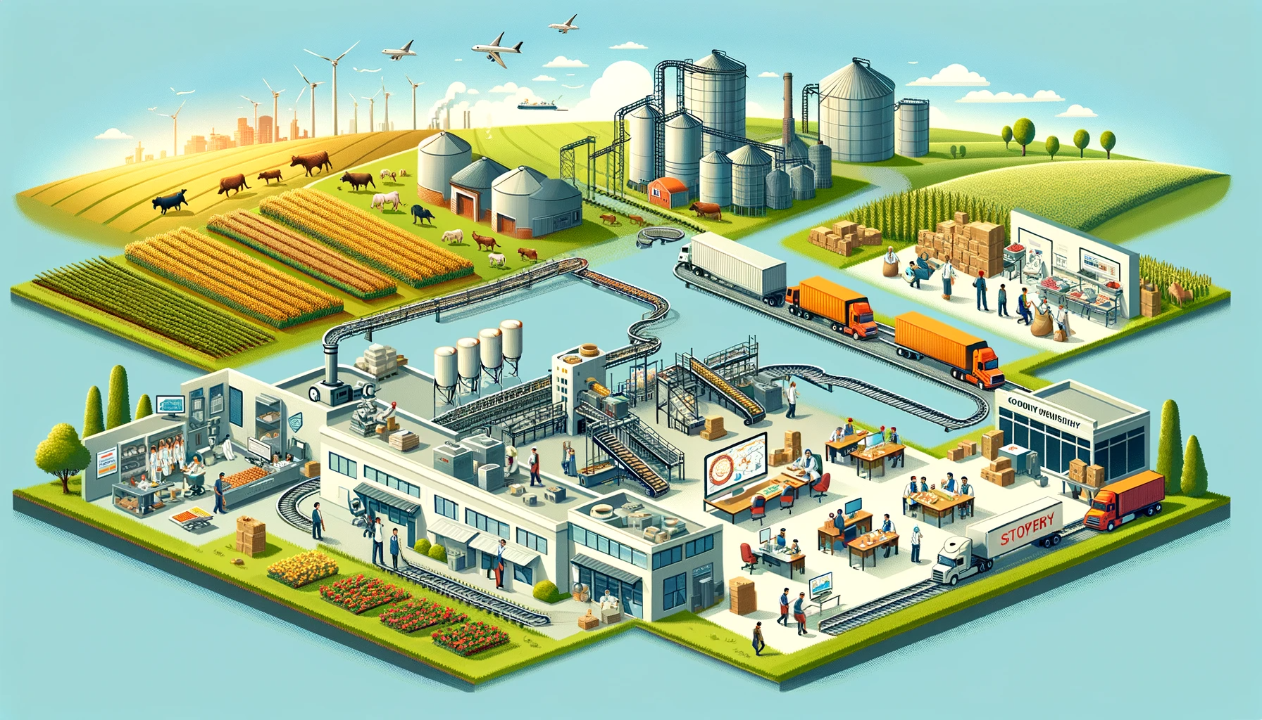
PROJECT TEAM:
TIMIPIRI GODGIFT
OLUWAGBADE ODIMAYO

Slide 3
BUSINESS INTRODUCTION:
Velocity Railways is a leading railway operator based in the United Kingdom, dedicated to providing efficient, reliable, and timely train services across the nation.
The company leverages cutting-edge technology and real-time data integration to ensure its customers receive up-to-the-minute information on train schedules, departures, and arrivals.

Slide 4
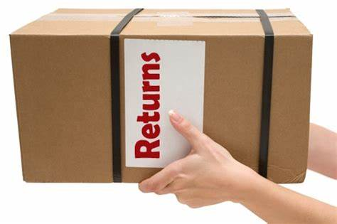

PROBLEM STATEMENT:
The company is currently facing challenges in providing accurate and real-time train departure information to its passengers.
The current system provides scheduled departure times but often lacks real-time updates on delays, cancellations, or other disruptions.
The company wants to create a better pipeline that fetches real-time data from a source and saves it on a database for further usages.

Slide 5
TECH STACK SUMMARY:
Python + Requests: For API calls and initial data ingestion.
Kafka: For streaming real-time data and ensuring scalable, fault-tolerant message processing.
Great Expectations: For validating data dynamically to ensure data quality.
Airflow: To orchestrate the entire pipeline (scheduling, retries, alerts, etc.).
Azure + PostgreSQL: For storing validated data with high availability and fault tolerance.

Slide 6
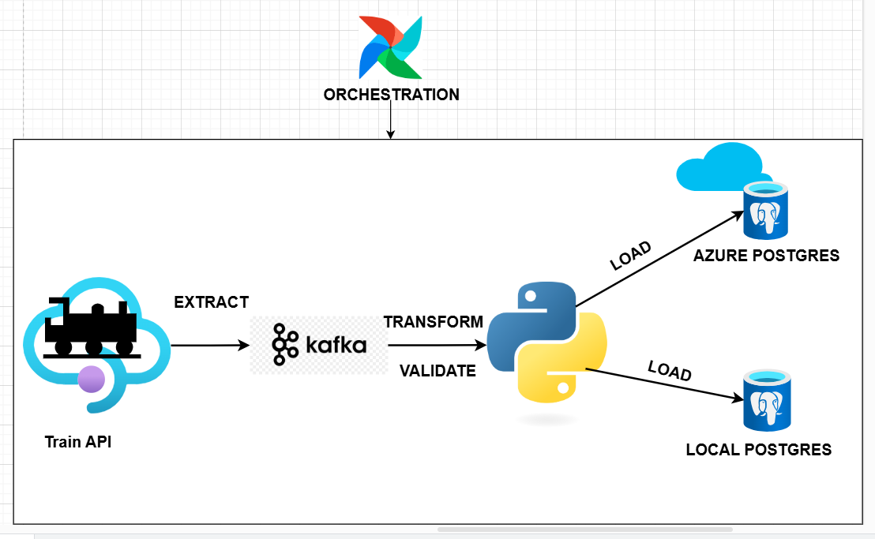

Slide 7

HIGH LEVEL STEPS:
Install requirements
Import necessary Libraries
Logic for Data Ingestion
Logic for Data Transformation
Logic for Data Validation
Logic for Data Duplication
Dag for Pipeline Orchestration

Slide 8
THANK YOU

